Slide 1

Lab 7: Electric Motor
PHY2049L
Section: 016

Slide 2
Learning Outcomes
Students will how a current carrying coil behaves in the presence of a magnetic field.
Students will gain experience in applying physical principals to develop a motor.

Slide 3
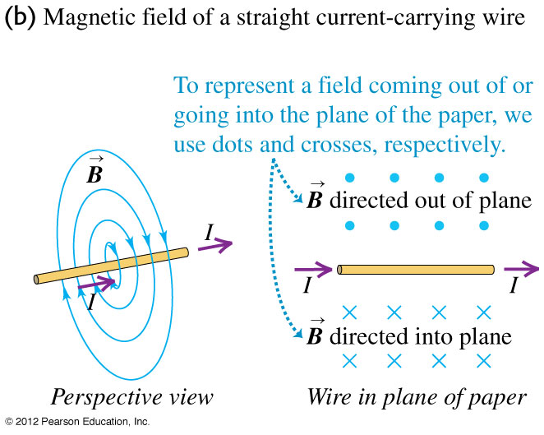
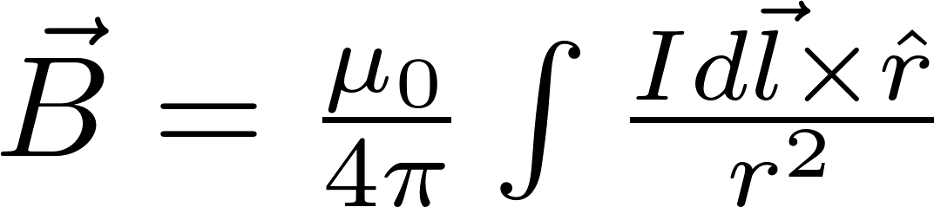
Current Carrying Wire
A current carrying wire induces a magnetic field.
We use the right hand rule to find the direction of the magnetic field.

Slide 4
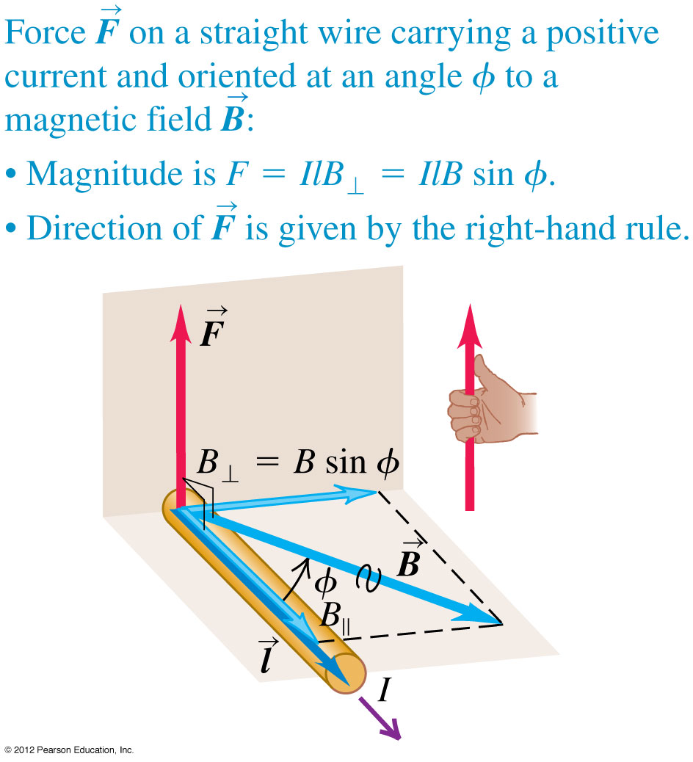
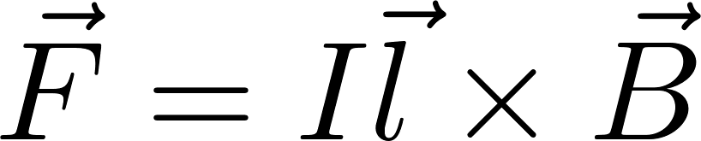
Current Carrying Wire in a Magnetic Field
A current carrying wire placed in a magnetic field experiences a force due to the magnetic field.
The direction is also given by a right-hand rule.

Slide 5
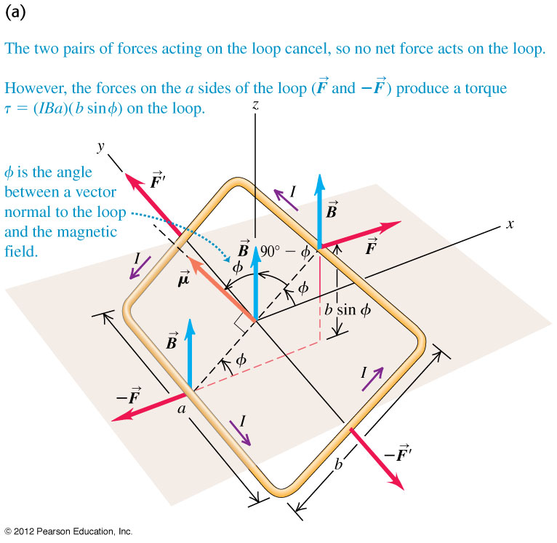
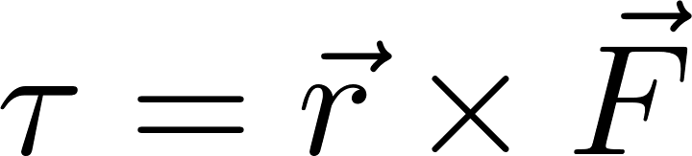
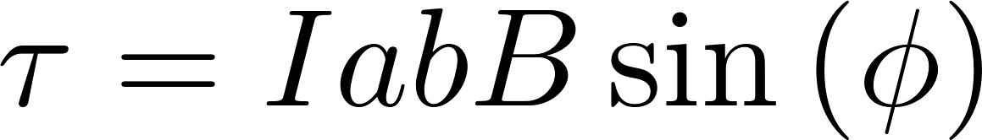
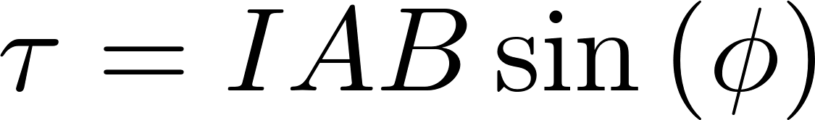
Current Carrying Loop in a Magnetic Field
We can analyze the force experienced by a current carrying loop in a magnetic field.
Notice that the net force is zero, but the net torque is not zero.

Slide 6
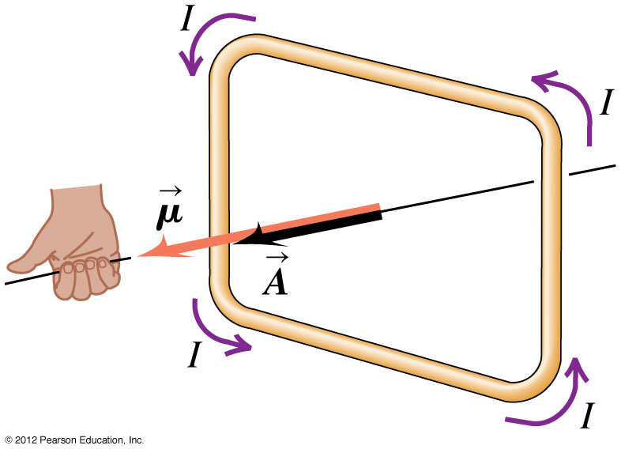
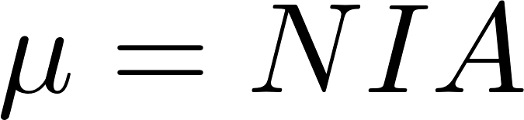
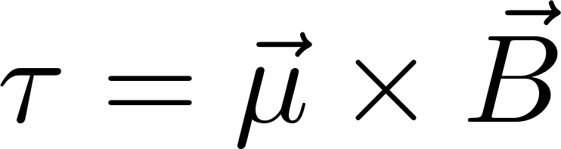
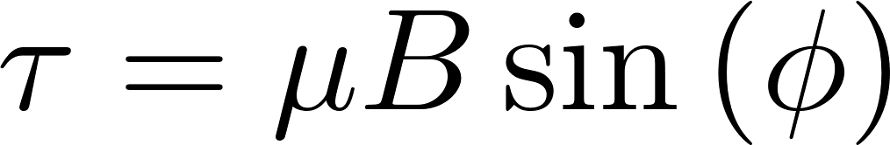
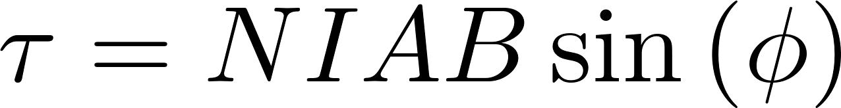
Magnetic Moment
Another way to think about it is with “magnetic moment”.
The current in the wire sets up a magnetic field within the coil. This magnetic field is related to the “magnetic moment” of the coil. However, it is only dependent on the current through the coil, number of turns and area of the coil.
When the magnetic moment is placed in an external magnetic field, it wants to align with that field. Therefore it experiences a torque that attempts to align it.

